Slide 1
Prediction for change
Team Name: byTeam
Shaashwat Jain
Rajdeep Sengupta
Raghav Aggarwal
Saurav Nayak

Slide 2
Introduction
In order to keep up the pace with the markets, a huge number of people invest in stock market prediction algorithms.
We use a new kind of approach in doing so by using web scraped data and predicting our confidence in the prediction independent to the prediction.
We are also using charitable profits to help mankind and poverty.

Slide 3
THOUGHT PROCESS
We check for a company that whether negative tweets are more than positive tweets or negative tweets are more than 30% of the total sample taken, then we recommend the user that the stock market is unstable and not to invest in it at that time.
Otherwise we can conclude of a strong confidence level and plot the nature of the graph. We can be sure that the market cannot change drastically.
Finally we have a unique idea of donating 20% or above of the profit generated by our prediction to the charity.

Slide 4
Concepts used
RCNN(Recurring Convolutional Neural Network) to plot graphs of company history in the market.
NLP(Natural Language Processing) to preprocess the tweets and discard the junk values.
Sentiment Analysis using TextBlob library in python.
Web Scraping of twitter handles using API keys to get recent tweets of companies.
MIT App Inventor to make an app for this purpose.

Slide 5
Future scope
It can be implemented in realtime.
We can figure out what causes confidence level to drop.
We can use some algorithms to identify the sarcastic tweets which are slightly affecting the results.

Slide 6
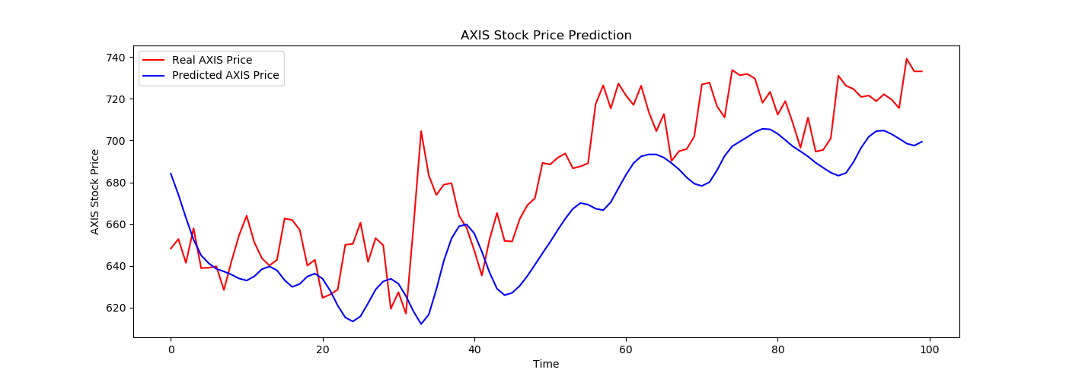
AXIS BANK PREDICTION ACCURACY

Slide 7
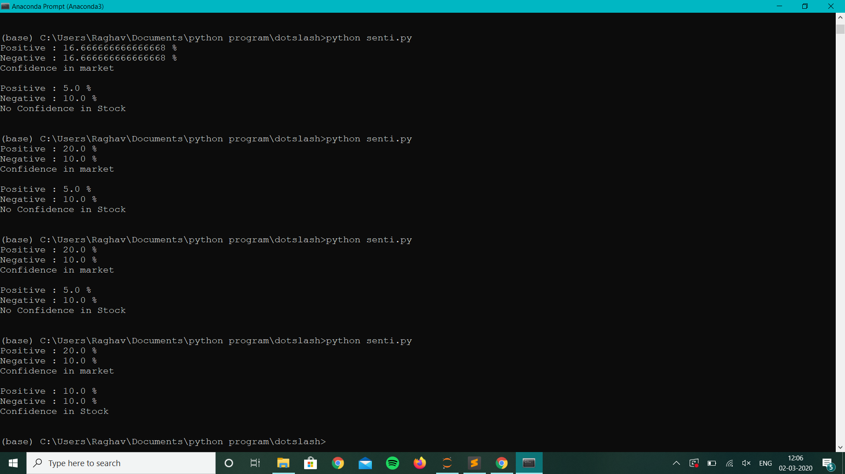

Slide 8
